Slide 1
PROJECT REPORTS
Forecasting Sales of 1115 Drug Stores in Advance for the Test Set
BY : AKESH KUMAR

Slide 2
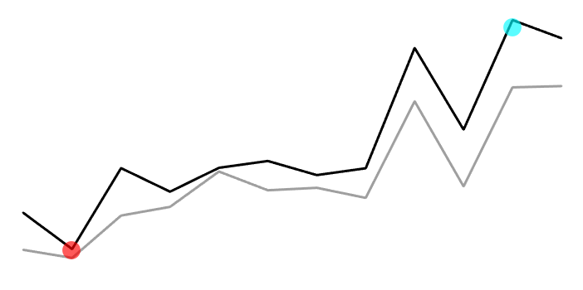
FORECASTING SALES
PROBLEM STATEMENT
COMPANY OVERVIEW
Operates over 3,000 drug stores across 7 countries.
Store managers predict daily sales up to six weeks in advance.
Sales influenced by promotions, competition, holidays, seasonality, and locality.

Slide 3
FORECASTING SALES
PROBLEM STATEMENT
DATA OVERVIEW
Historical sales data available for 1,115 XYZ Drug stores.
Objective: Forecast the "Sales" column for the test set.
Note: Some stores were temporarily closed for refurbishment.

Slide 4
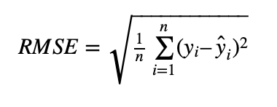
Model Evaluation Metrics

Slide 5



HOW DATA LOOKS LIKE ?
Store, DayOfWeek, Date, Sales, Customers, Open, Promo, StateHoliday, SchoolHoliday, StoreType, Assortment, CompetitionDistance, CompetitionOpenSinceMonth, CompetitionOpenSinceYear, Promo2, Promo2SinceWeek, Promo2SinceYear, PromoInterval
Store, DayOfWeeK, Date, Sales, Customers, Open, Promo, StateHoliday, SchoolHoliday
SALES.CSV
STORE.CSV
1017209 ×9
MERGED
1115×10
Store, StoreType, Assortment, CompetitionDistance, CompetitionOpenSinceMonth, CompetitionOpenSinceYear, Promo2, Promo2SinceWeek, Promo2SinceYear, PromoInterval
On Common field Store
1017209 ×18

Slide 6
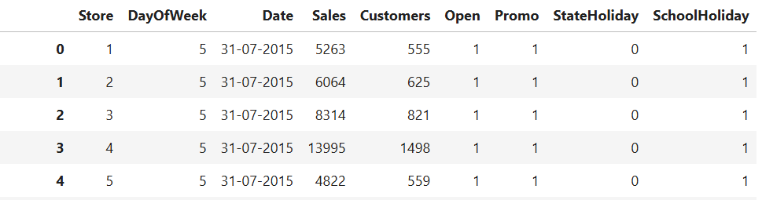
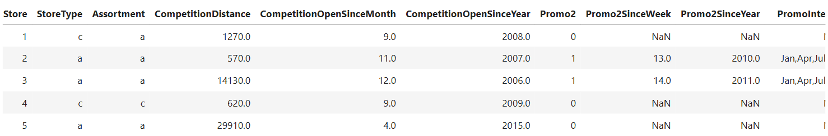
HOW DATA LOOKS LIKE ?
STORE
SALES
SALES.CSV

Slide 7
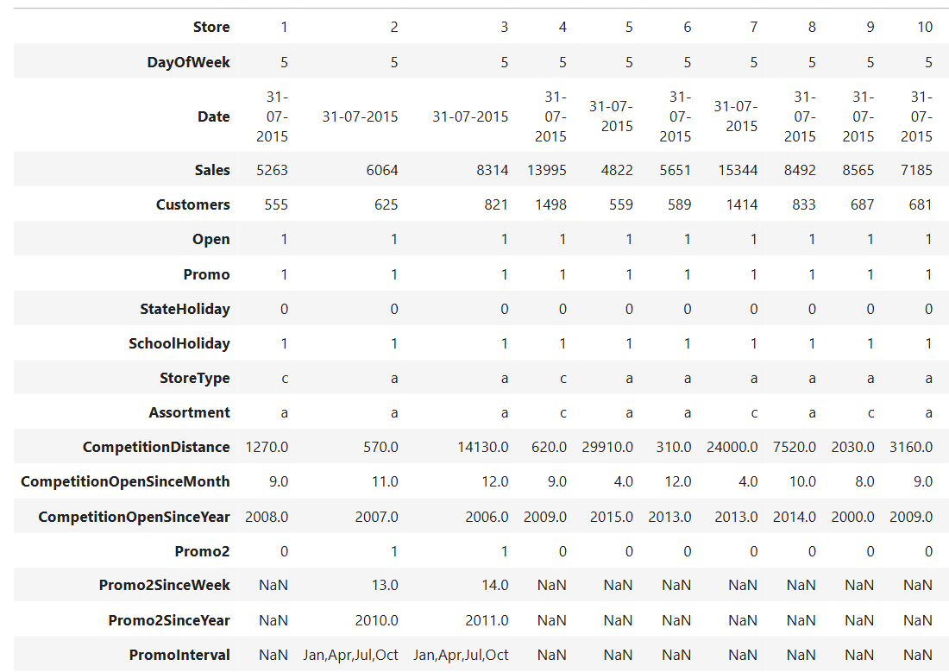
HOW DATA LOOKS LIKE ?
MERGED

Slide 8
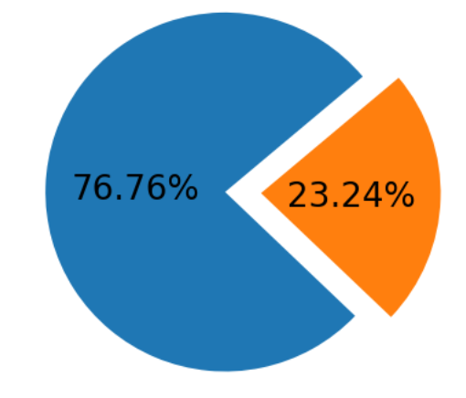
HOW DATA LOOKS LIKE ?
TRAIN
TEST
780829×22
236380×22

Slide 9
HOW DATA LOOKS LIKE ?
TRAIN
TEST
INFERENCES:
TRAIN - This set contains data from 2013-01-01 to 2014-12-31.
TEST - This set contains data from 2015-01-01 to 2015-07-31.
Objective is to Forecast sales for 2015 upto 31st, July.
780829×22
236380×22

Slide 10
How Model is Selected ?
When selecting a model, we need to consider the following:
Our dataset is quite large, so simple machine learning algorithms may have trouble with training.
If the data has a linear relationship, we will use a linear hypothesis and employ Stochastic Gradient Descent.
If the data is non-linear, we will resort to using XGBoost or deep learning techniques, as we have enough data and the facilities to train machine learning models on large datasets using GPUs.

Slide 11
What Features Say ?

Slide 12
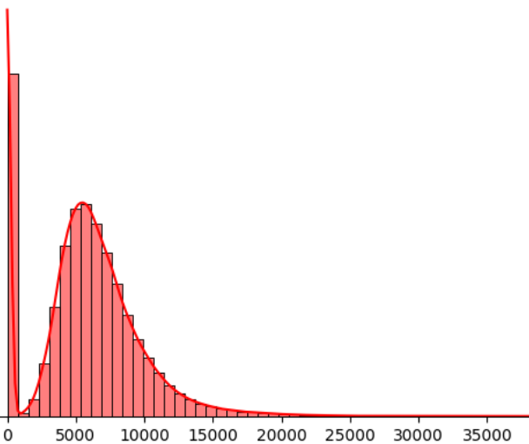
# SALES & OPEN
INFERENCES:
Sales seems LogNoramally distributed with Alot of zero values.
Why Zeros?: Many entries are recorded with zero sales, Even when Store is Closed, Also Holidays & Refurbishment might be another reason.
BEFORE

Slide 13
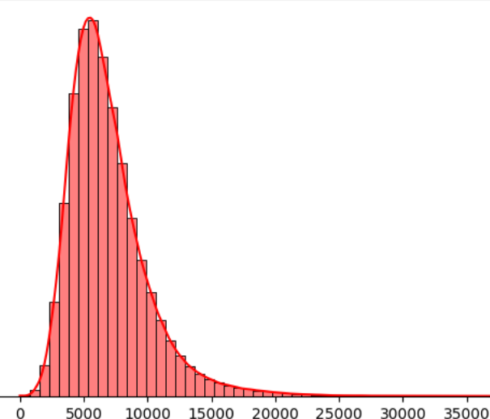
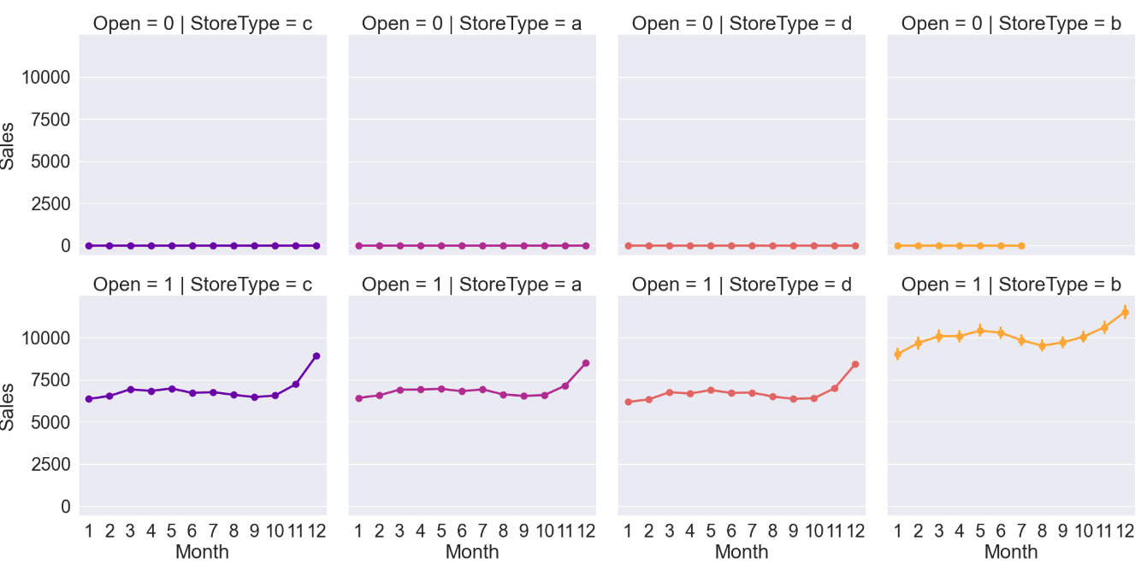

# SALES, Open & StoreType
AFTER
INFERENCES:
It is clear that when Stores are Closed, then they are not contributing to sales. Also entries did’nt contributes in forecasting.
Therefore better to Drop these 130k enteries.

Slide 14
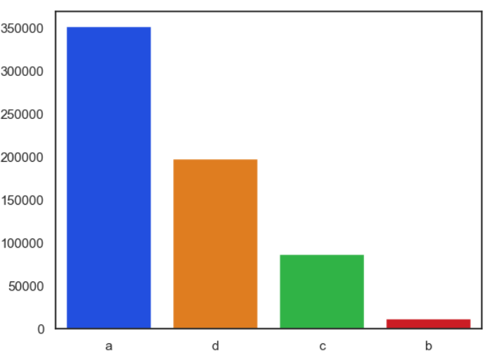
StoreType
351476
INFERENCES:
We have highest no. of records of store Type a then d, then c and in last and least StoreType b.
197846
87076
11959

Slide 15
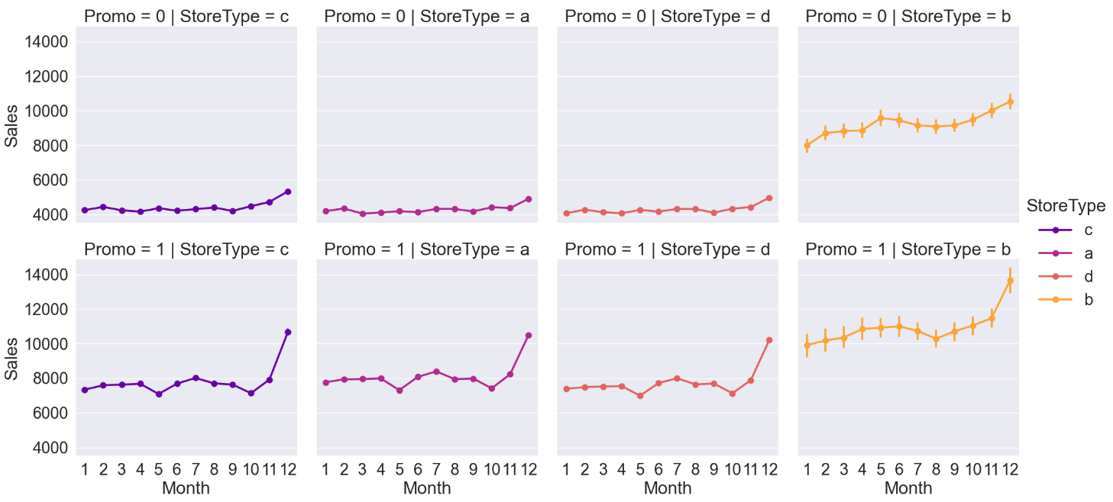
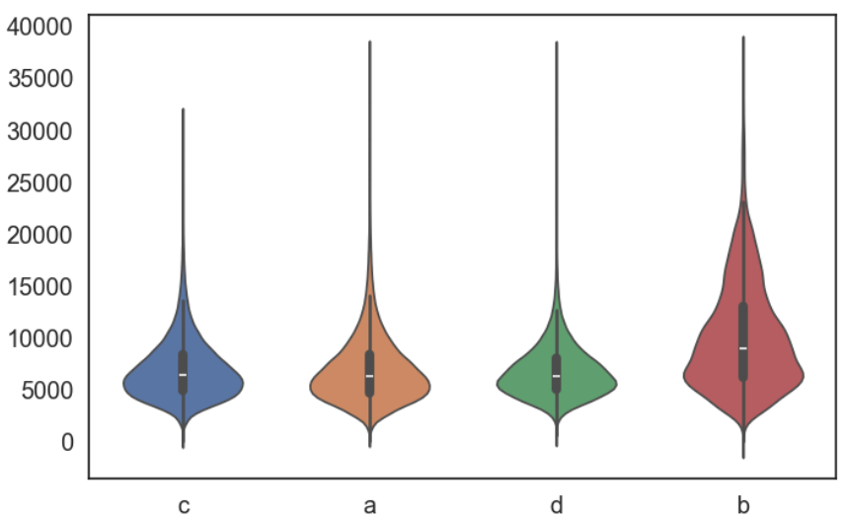
SALES, PROMO
& StoreType
INFERENCES:
Sales are positively affected when the store is running a promotion.
For StoreType C, A, and D, sales have increased by Factor 1.6, and 1.2 for B.
Noticeable upward trend in sales even without promo for B where as for other it was neutral. (Probable B is performing well then others)

Slide 16
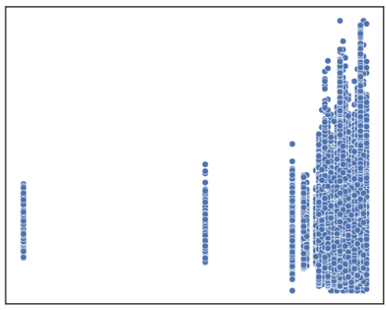
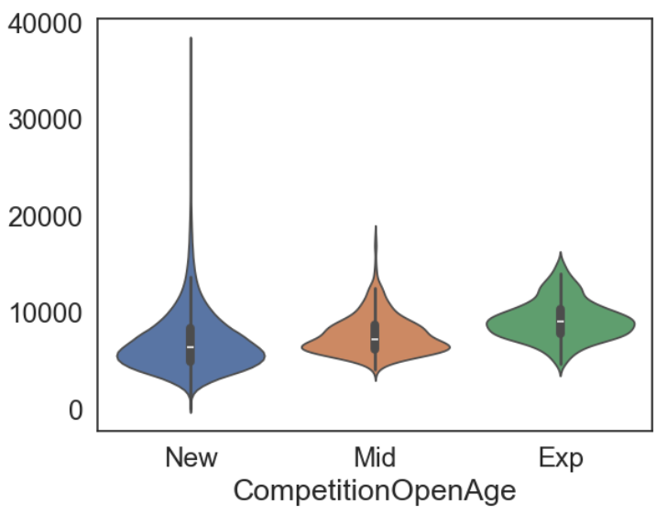
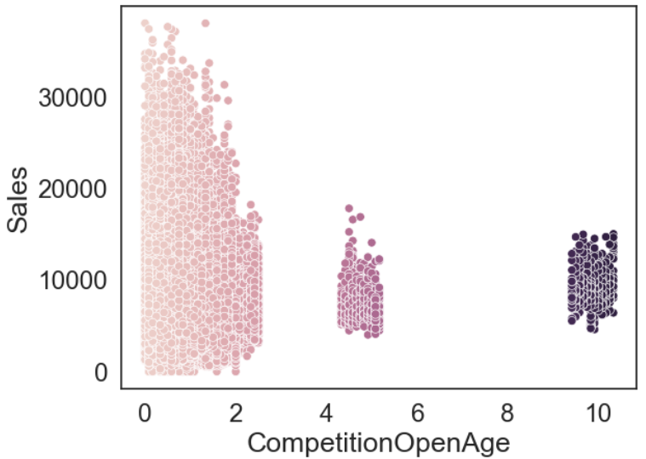
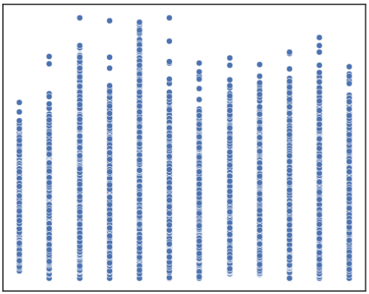
# SALES & CompetitionOpenSince
YEAR
MONTH
INFERENCES:
Most of the Competitors are of recent years.
Combined Year & Month details of competition for better information gain.
In term of Sales, Compare to Recent Competitor, Client’s Stores are performing well.
Client has to work with better strategy in front of old players.

Slide 17
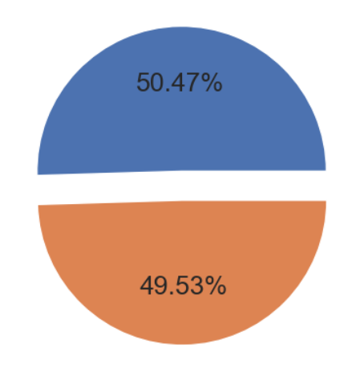
# Promo2
INFERENCES:
50% Sales are recorded where stores are continuing promotion.

Slide 18
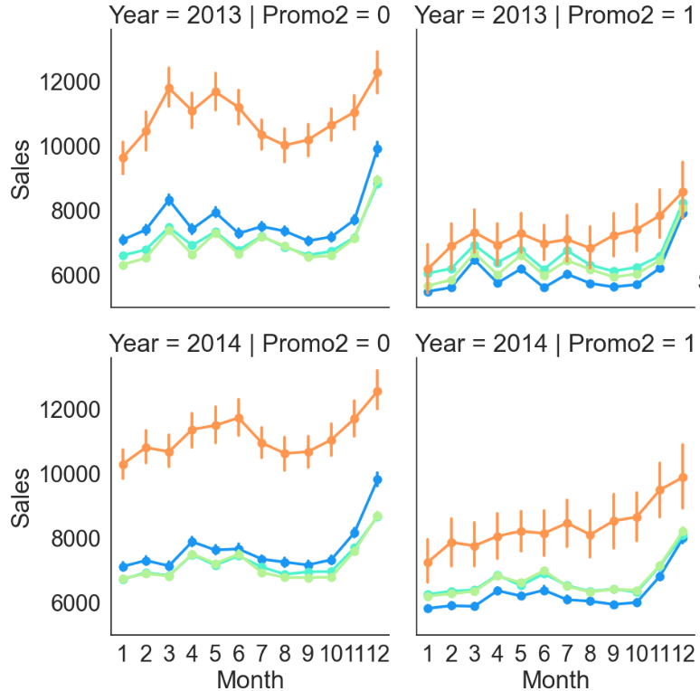
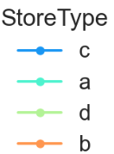
# Promo2, YEAR,
Month, Sales
INFERENCES:
Participating in Promo2 does not seems to be benificial in term of Sales.
Our Best performer Store type B also faced downfall in overall sales as in 2013 it even failed to reach Minimum sales.

Slide 19
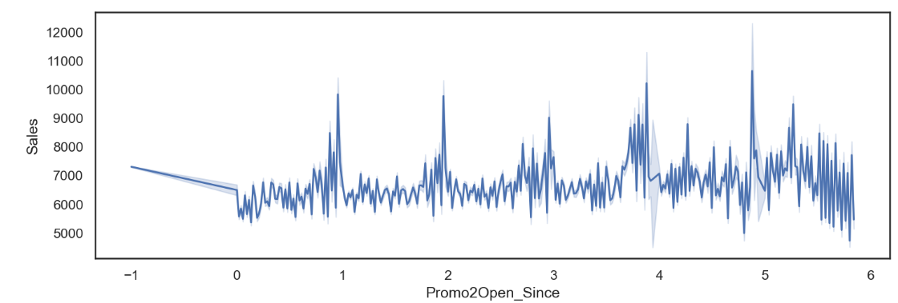
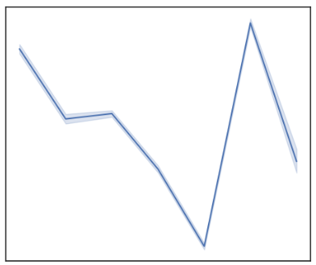
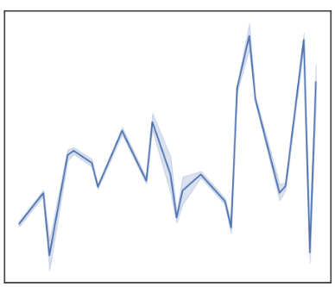
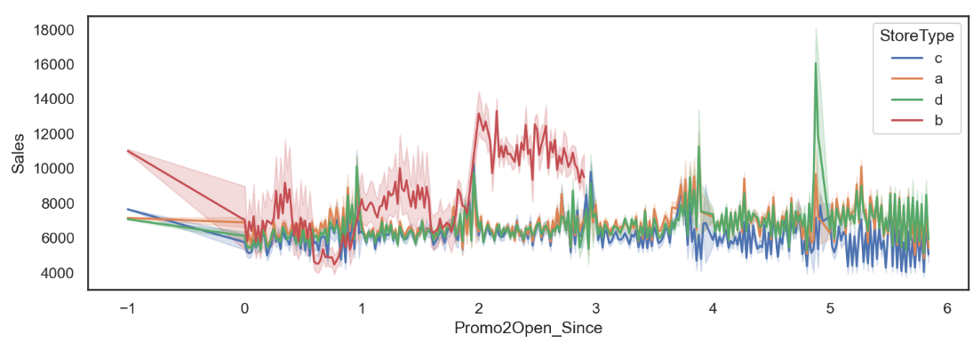
Promo2SinceYear, Promo2SinceWeek
YEAR
WEEK
Promo2
Open_Since
INFERENCES:
Downward drift in average sales proved Our Previous claim regarding negative Effect of participating in Promo2.
Store TypeB shown unstable increase in average sales with lots of Fluctuations .

Slide 20
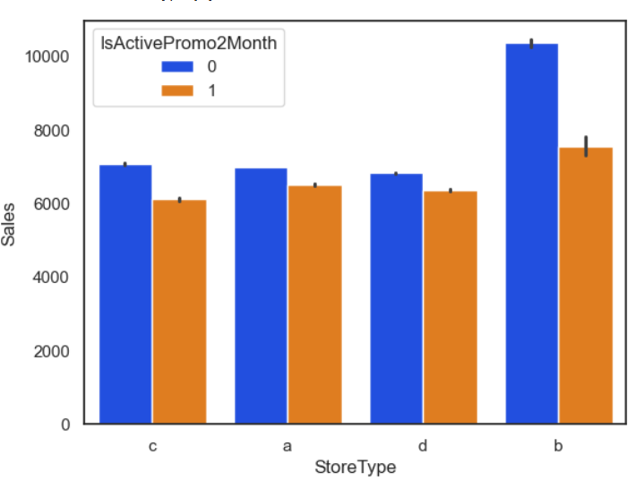

PromoInterval
0
IsActive
Promo2
Month
1
INFERENCES:
New binary Feature is Engineered IsActivePromo2Month.
It States Whether a new round of promotions started in current month.
Another proof of negitive effect of participating in new rounds of Promotions.

Slide 21


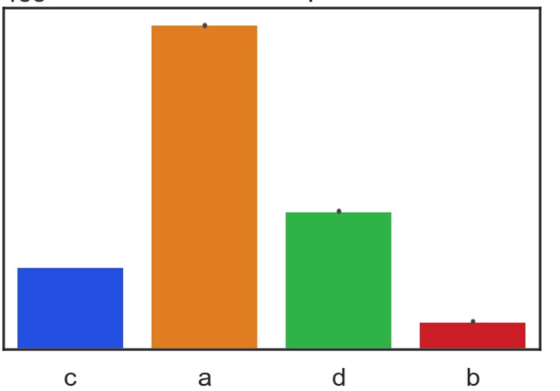
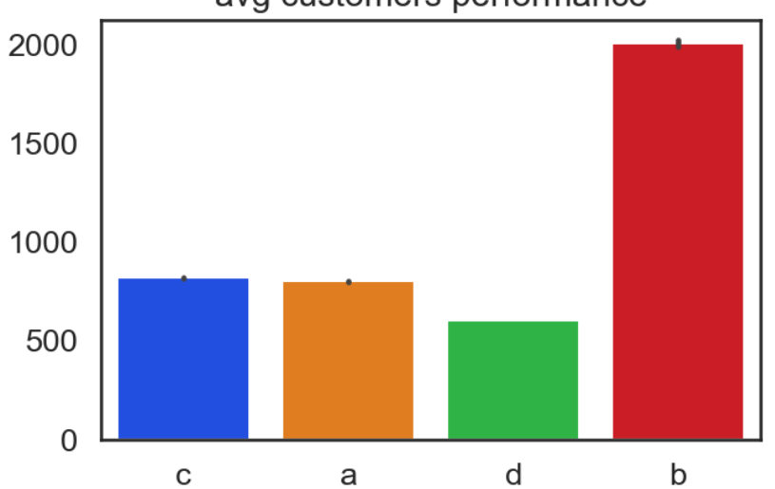
# Customers & StoreType
Overall Customer Served
Average Customer Served
INFERENCES:
Store Type a served most of the customers, as the type a stores are also highest.
But again Store Type b served double(approx) customer in term of average.
As our end goal is to forecast sales we wont take obeservations with 0 customer.

Slide 22
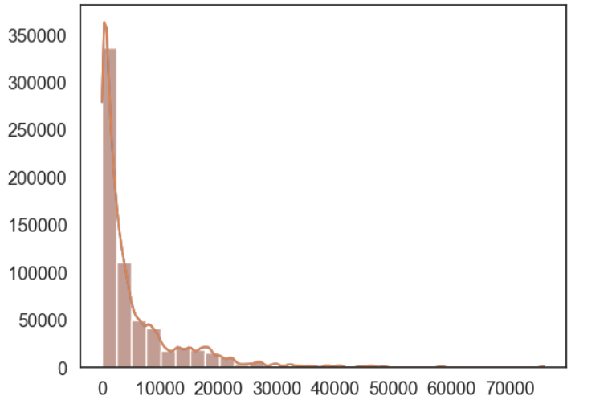
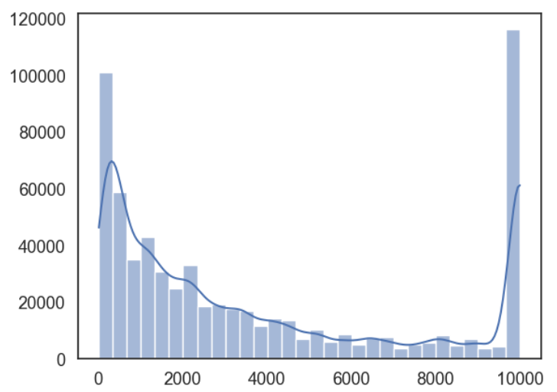
# CompetitionDistance
INFERENCES:
Competition Distance feature follow approximately pareto distribution.
It States that Most of Competitors comapnies are Near to client’s Stores and very few are far then 10000.
Capped Distribution with [0,10000] limit.
Distance

Slide 23
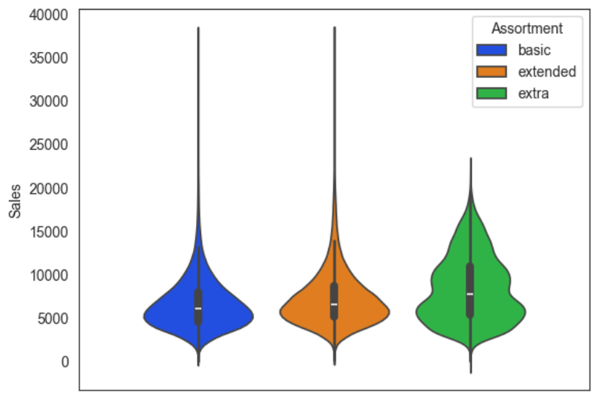
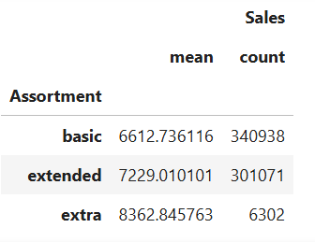
# Assortment
INFERENCES:
No. of sales are are highest in basic Level Assortment.
Avg sales are highest In Assortment level extra even though No. of sales are less.

Slide 24
Model

Slide 25

HOW DATA LOOKS LIKE ?
Donec sollicitudin molestie malesuada
vestibulum ante ipsum primis in faucibus orci luctus et ultrices posuere cubilia curae; donec velit neque, auctor sit amet aliquam vel, ullamcorper sit amet ligula. nulla quis lorem ut libero malesuada feugiat. vestibulum ac diam sit amet quam vehicula
Vestibulum ante ipsum primis in faucibus orci luctus et ultrices posuere cubilia Curae; Donec velit neque, auctor sit amet aliquam vel, ullamcorper sit amet ligula. Nulla quis lorem ut libero malesuada feugiat. Vestibulum ac diam sit amet quam vehiculaVestibulum ante ipsum primis in faucibus orci luctus et ultrices posuere cubilia Curae; Donec velit neque, auctor sit amet aliquam vel, ullamcorper sit amet ligula. Nulla quis lorem ut libero malesuada feugiat. Vestibulum ac diam sit amet quam vehicula

Slide 26




Your Title Here
ADD YOUR TEXT
ADD YOUR TEXT
Vestibulum ante ipsum primis in faucibus orciVestibulum ante ipsum
Vestibulum ante ipsum primis in faucibus orciVestibulum ante ipsum
ADD YOUR TEXT
ADD YOUR TEXT
Vestibulum ante ipsum primis in faucibus orciVestibulum ante ipsum
Vestibulum ante ipsum primis in faucibus orciVestibulum ante ipsum

Slide 27




Your Title Here
ADD YOUR TEXT
ADD YOUR TEXT
Vestibulum ante ipsum primis in faucibus orciVestibulum ante ipsum primis in faucibus orci
Vestibulum ante ipsum primis in faucibus orciVestibulum ante ipsum primis in faucibus orci
ADD YOUR TEXT
ADD YOUR TEXT
Vestibulum ante ipsum primis in faucibus orciVestibulum ante ipsum primis in faucibus orci
Vestibulum ante ipsum primis in faucibus orciVestibulum ante ipsum primis in faucibus orci

Slide 28


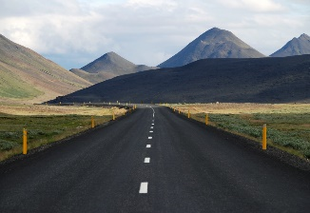

Your Title Here
ADD YOUR TEXT
DONEC SOLLICITUDIN MOLESTIE MALESUADA
Vestibulum ante ipsum primis in faucibus orci luctus et ultrices posuere cubilia Curae; Donec velit neque, auctor sit amet aliquam vel, ullamcorper sit amet ligula. Nulla quis lorem ut libero malesuada feugiat. Vestibulum ac diam sit amet quam vehicula

Slide 29



Your Title Here
ADD YOUR TEXT
ADD YOUR TEXT
ADD YOUR TEXT
Vestibulum ante ipsum primis in faucibus orci luctus et ultrices posuere cubilia Curaeultrices posuere cubilia Curae
Vestibulum ante ipsum primis in faucibus orci luctus et ultrices posuere cubilia Curaeultrices posuere cubilia Curae
Vestibulum ante ipsum primis in faucibus orci luctus et ultrices posuere cubilia Curaeultrices posuere cubilia Curae

Slide 30
SECTION TITLE
Quisque velit nisi, pretium ut lacinia in, elementum id enim. Cras ultricies ligula sed magna dictum porta. Quisque velit nisi, pretium ut lacinia in, elementum id enim. Vivamus magna justo, lacinia eget consectetur sed.

Slide 31
Your Title Here
Ante ipsum primis in faucibus orci luctus et ultrices posuere cubilia curae; donec velit neque.
2016
2017
Ante ipsum primis in faucibus orci luctus et ultrices posuere cubilia curae; donec velit neque.
Ante ipsum primis in faucibus orci luctus et ultrices posuere cubilia curae; donec velit neque.
2014
Ante ipsum primis in faucibus orci luctus et ultrices posuere cubilia curae; donec velit neque.
2015

Slide 32
Your Title Here
ADD YOUR TEXT
Vestibulum ante ipsum primis in faucibus orci luctus et ultrices posuere
ADD YOUR TEXT
Vestibulum ante ipsum primis in faucibus orci luctus et ultrices posuere
ADD YOUR TEXT
Vestibulum ante ipsum primis in faucibus orci luctus et ultrices posuere
ADD YOUR TEXT
Vestibulum ante ipsum primis in faucibus orci luctus et ultrices posuere

Slide 33
Your Title Here
TEXT
1
ADD YOUR TEXT
Vestibulum ante ipsum primis in faucibus orci luctus et ultrices posuere cubilia Curae
TEXT
2
ADD YOUR TEXT
Vestibulum ante ipsum primis in faucibus orci luctus et ultrices posuere cubilia Curae
TEXT
4
TEXT
3
ADD YOUR TEXT
Vestibulum ante ipsum primis in faucibus orci luctus et ultrices posuere cubilia Curae
TEXT
5
ADD YOUR TEXT
ADD YOUR TEXT
Vestibulum ante ipsum primis in faucibus orci luctus et ultrices posuere cubilia Curae
Vestibulum ante ipsum primis in faucibus orci luctus et ultrices posuere cubilia Curae

Slide 34
Your Title Here
ADD YOUR TEXT
ADD YOUR TEXT
Vestibulum ante ipsum primis in faucibus orci luctus et ultrices posuere cubilia Curae.
Vestibulum ante ipsum primis in faucibus orci luctus et ultrices posuere cubilia Curae.
ADD YOUR TEXT
ADD YOUR TEXT
Vestibulum ante ipsum primis in faucibus orci luctus et ultrices posuere cubilia Curae.
Vestibulum ante ipsum primis in faucibus orci luctus et ultrices posuere cubilia Curae.

Slide 35
Your Title Here
60%
45%
40%
30%
ADD YOUR TEXT
ADD YOUR TEXT
ADD YOUR TEXT
ADD YOUR TEXT
Vestibulum ante ipsum primis in faucibus orci luctus et ultrices posuere cubilia Curae
Vestibulum ante ipsum primis in faucibus orci luctus et ultrices posuere cubilia Curae
Vestibulum ante ipsum primis in faucibus orci luctus et ultrices posuere cubilia Curae
Vestibulum ante ipsum primis in faucibus orci luctus et ultrices posuere cubilia Curae

Slide 36
SECTION TITLE
Quisque velit nisi, pretium ut lacinia in, elementum id enim. Cras ultricies ligula sed magna dictum porta. Quisque velit nisi, pretium ut lacinia in, elementum id enim. Vivamus magna justo, lacinia eget consectetur sed.

Slide 37
Your Title Here
ADD YOUR TEXT
Vestibulum ante ipsum primis in faucibus orci luctus et ultrices posuere cubilia Curae.
ADD YOUR TEXT
Vestibulum ante ipsum primis in faucibus orci luctus et ultrices posuere cubilia Curae.
ADD YOUR TEXT
Vestibulum ante ipsum primis in faucibus orci luctus et ultrices posuere cubilia Curae.
ADD YOUR TEXT
Vestibulum ante ipsum primis in faucibus orci luctus et ultrices posuere cubilia Curae.

Slide 38
Your Title Here
ADD YOUR TEXT
Vestibulum ante ipsum primis in faucibus orci luctus et ultrices posuere
ADD YOUR TEXT
Vestibulum ante ipsum primis in faucibus orci luctus et ultrices Vestibulum ante ipsum primis in faucibus orci luctus et ultrices posuere.
ADD YOUR TEXT
Vestibulum ante ipsum primis in faucibus orci luctus et ultrices posuere
ADD YOUR TEXT
Vestibulum ante ipsum primis in faucibus orci luctus et ultrices Vestibulum ante ipsum primis in faucibus orci luctus et ultrices posuere.
ADD YOUR TEXT
Vestibulum ante ipsum primis in faucibus orci luctus et ultrices posuere

Slide 39
Your Title Here
ADD YOUR TEXT
Vestibulum ante ipsum primis in faucibus orci luctus et ultrices posuere cubilia Curae.
ADD YOUR TEXT
Vestibulum ante ipsum primis in faucibus orci luctus et ultrices posuere cubilia Curae.
ADD YOUR TEXT
Vestibulum ante ipsum primis in faucibus orci luctus et ultrices posuere cubilia Curae.
ADD YOUR TEXT
Vestibulum ante ipsum primis in faucibus orci luctus et ultrices.
Vestibulum ante ipsum primis in faucibus orci luctus et ultrices posuere cubilia Curae.

Slide 40

Your Title Here
79%
ADD YOUR TEXT
Vestibulum ante ipsum primis in faucibus orci luctus et ultrices
71%
ADD YOUR TEXT
Vestibulum ante ipsum primis in faucibus orci luctus et ultrices
69%
ADD YOUR TEXT
Vestibulum ante ipsum primis in faucibus orci luctus et ultrices
TEXT HERE
61%
ADD YOUR TEXT
Vestibulum ante ipsum primis in faucibus orci luctus et ultrices
48%
ADD YOUR TEXT
Vestibulum ante ipsum primis in faucibus orci luctus et ultrices
38%
ADD YOUR TEXT
Vestibulum ante ipsum primis in faucibus orci luctus et ultrices

Slide 41
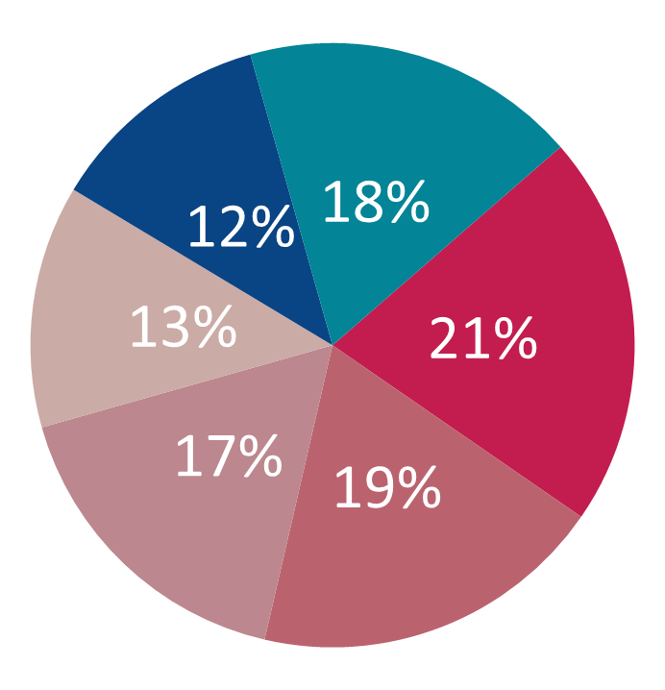
Your Title Here
ADD YOUR TEXT
ADD YOUR TEXT
Vestibulum ante ipsum primis in faucibus orci luctus et ultrices posuere cubilia Curae
Vestibulum ante ipsum primis in faucibus orci luctus et ultrices posuere cubilia Curae
ADD YOUR TEXT
Vestibulum ante ipsum primis in faucibus orci luctus et ultrices posuere cubilia Curae
ADD YOUR TEXT
Vestibulum ante ipsum primis in faucibus orci luctus et ultrices posuere cubilia Curae
ADD YOUR TEXT
ADD YOUR TEXT
Vestibulum ante ipsum primis in faucibus orci luctus et ultrices posuere cubilia Curae
Vestibulum ante ipsum primis in faucibus orci luctus et ultrices posuere cubilia Curae

Slide 42
THANKS FORWATCHING
Add your text

